Slide 1
Reinforcement Learning

Slide 2
Agenda
Online learning
Reinforcement learning
Model-free vs. model-based
Passive vs. active learning
Exploration-exploitation tradeoff

Slide 3
Incremental (“Online”) Function Learning
Data is streaming into learner x₁,y₁, …, x_{n},y_{n} y_{i} = f(x_{i})
Observes x_{n+1} and must make prediction for next time step y_{n+1}
“Batch” approach:
Store all data at step n
Use your learner of choice on all data up to time n, predict for time n+1
Can we do this using less memory?

Slide 4
Example: Mean Estimation
y_{i} = θ + error term (no x’s)
Current estimate θ_{n} = 1/n Σ_{i=1…n} y_{i}
θ_{n+1} = 1/(n+1) Σ_{i=1…n+1} y_{i} = 1/(n+1) (y_{n+1} + Σ_{i=1…n} y_{i}) = 1/(n+1) (y_{n+1} + n θ_{n}) = θ_{n} + 1/(n+1) (y_{n+1} - θ_{n})
θ₅

Slide 5
Example: Mean Estimation
y_{i} = θ + error term (no x’s)
Current estimate θ_{t} = 1/n Σ_{i=1…n} y_{i}
θ_{n+1} = 1/(n+1) Σ_{i=1…n+1} y_{i} = 1/(n+1) (y_{n+1} + Σ_{i=1…n} y_{i}) = 1/(n+1) (y_{n+1} + n θ_{n}) = θ_{n} + 1/(n+1) (y_{n+1} - θ_{n})
y₆
θ₅

Slide 6
Example: Mean Estimation
y_{i} = θ + error term (no x’s)
Current estimate θ_{t} = 1/n Σ_{i=1…n} y_{i}
θ_{n+1} = 1/(n+1) Σ_{i=1…n+1} y_{i} = 1/(n+1) (y_{n+1} + Σ_{i=1…n} y_{i}) = 1/(n+1) (y_{n+1} + n θ_{n}) = θ_{n} + 1/(n+1) (y_{n+1} - θ_{n})
θ₅
θ₆ = 5/6 θ₅ + 1/6 y₆

Slide 7
Example: Mean Estimation
θ_{n+1} = θ_{n} + 1/(n+1) (y_{n+1} - θ_{n})
Only need to store n, θ_{n}
θ₅
θ₆ = 5/6 θ₆ + 1/6 y₆

Slide 8
Learning Rates
In fact, θ_{n+1} = θ_{n} + α_{n} (y_{n+1} - θ_{n}) converges to the mean for any α_{n} such that:
α_{n} → 0 as n → ∞
Σα_{n} → ∞
Σα_{n}² → C < ∞
O(1/n) does the trick
If α_{n} is close to 1, then the estimate shifts strongly to recent data; close to 0, and the old estimate is preserved

Slide 9
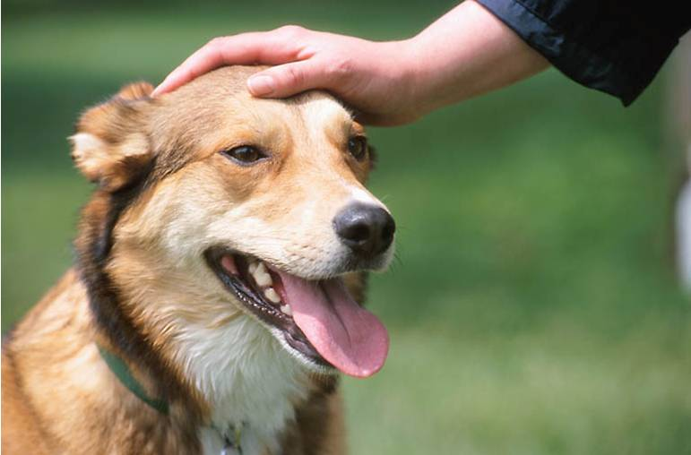
Reinforcement Learning
RL problem: given only observations of actions, states, and rewards, learn a (near) optimal policy
No prior knowledge of transition or reward models
We consider: fully-observable, episodic environment, finite state space, uncertainty in action (MDP)

Slide 10
What to Learn?
Model free
Model based
Less online deliberation
More online deliberation
Action-utility function Q(s,a)
Utility function U
Model of R and T
Learn:
Policy π
Online:
π(s)
arg max_{a} Q(s,a)
arg max_{a} Σ_{s} P(s’|s,a)U(s’)
Solve MDP
Method:
Learning from demonstration
Q-learning, SARSA
Direct utility estimation, TD-learning
Adaptive dynamic programming
Simpler execution
Fewer examples needed to learn?

Slide 11
First steps: Passive RL
Observe execution trials of an agent that acts according to some unobserved policy π
Problem: estimate the utility function U^{π}
[Recall U^{π}(s) = E[Σ_{t} γ^{t} R(S_{t})] where S_{t} is the random variable denoting the distribution of states at time t]

Slide 12
Direct Utility Estimation
0
0
0
+1
0.81
0.87
0.92
+1
3
3
0
0
-1
0.76
0.66
-1
2
2
1
0
0
0
0
1
0.71
0.66
0.61
0.39
1
2
3
4
1
2
3
4
Observe trials t^{(i)}=(s₀^{(i)},a₁^{(i)},s₁^{(i)},r₁^{(i)},…,a_{ti}^{(i)},s_{ti}^{(i)},r_{ti}^{(i)}) for i=1,…,n
For each state s∈S:
Find all trials t^{(i)} that pass through s
Compute subsequent utility U^{t(i)}(s)=Σ_{t=k to ti} γ^{t-k} r_{t}^{(i)}
Set U^{π}(s) to the average observed utility

Slide 13
Online Implementation
0
0
0
+1
0.81
0.87
0.92
+1
3
3
0
0
-1
0.76
0.66
-1
2
2
1
0
0
0
0
1
0.71
0.66
0.61
0.39
1
2
3
4
1
2
3
4
Store counts N[s] and estimated utilities U^{π}(s)
After a trial t, for each state s in the trial:
Set N[s] ← N[s]+1
Adjust utility U^{π}(s) ← U^{π}(s)+α(N[s])(U^{t}(s)-U^{π}(s))
Simply supervised learning on trials
Slow learning, because Bellman equation is not used to pass knowledge between adjacent states

Slide 14
Temporal Difference Learning
0
0
0
+1
3
0
0
-1
2
1
0
0
0
0
1
2
3
4
Store counts N[s] and estimated utilities U^{π}(s)
For each observed transition (s,r,a,s’):
Set N[s] ← N[s]+1
Adjust utility U^{π}(s) ← U^{π}(s)+α(N[s])(r+γU^{π}(s’)-U^{π}(s))

Slide 15
Temporal Difference Learning
0
0
0
+1
3
0
0
-1
2
1
0
0
0
0
1
2
3
4
Store counts N[s] and estimated utilities U^{π}(s)
For each observed transition (s,r,a,s’):
Set N[s] ← N[s]+1
Adjust utility U^{π}(s) ← U^{π}(s)+α(N[s])(r+γU^{π}(s’)-U^{π}(s))

Slide 16
Temporal Difference Learning
0
0
0
+1
With learning rate α=0.5
3
0
0
-1
2
1
-0.02
0
0
0
1
2
3
4
Store counts N[s] and estimated utilities U^{π}(s)
For each observed transition (s,r,a,s’):
Set N[s] ← N[s]+1
Adjust utility U^{π}(s) ← U^{π}(s)+α(N[s])(r+γU^{π}(s’)-U^{π}(s))

Slide 17
Temporal Difference Learning
-0.02
-0.02
0
+1
With learning rate α=0.5
3
-0.02
0
-1
2
1
-0.02
0
0
0
1
2
3
4
Store counts N[s] and estimated utilities U^{π}(s)
For each observed transition (s,r,a,s’):
Set N[s] ← N[s]+1
Adjust utility U^{π}(s) ← U^{π}(s)+α(N[s])(r+γU^{π}(s’)-U^{π}(s))

Slide 18
Temporal Difference Learning
-0.02
-0.02
0.48
+1
With learning rate α=0.5
3
-0.02
0
-1
2
1
-0.02
0
0
0
1
2
3
4
Store counts N[s] and estimated utilities U^{π}(s)
For each observed transition (s,r,a,s’):
Set N[s] ← N[s]+1
Adjust utility U^{π}(s) ← U^{π}(s)+α(N[s])(r+γU^{π}(s’)-U^{π}(s))

Slide 19
Temporal Difference Learning
-0.04
0.21
0.72
+1
With learning rate α=0.5
3
-0.04
0
-1
2
1
-0.04
0
0
0
1
2
3
4
Store counts N[s] and estimated utilities U^{π}(s)
For each observed transition (s,r,a,s’):
Set N[s] ← N[s]+1
Adjust utility U^{π}(s) ← U^{π}(s)+α(N[s])(r+γU^{π}(s’)-U^{π}(s))

Slide 20
Temporal Difference Learning
0.07
0.44
0.84
+1
With learning rate α=0.5
3
-0.06
0
-1
2
1
-0.06
0
0
0
1
2
3
4
Store counts N[s] and estimated utilities U^{π}(s)
For each observed transition (s,r,a,s’):
Set N[s] ← N[s]+1
Adjust utility U^{π}(s) ← U^{π}(s)+α(N[s])(r+γU^{π}(s’)-U^{π}(s))

Slide 21
Temporal Difference Learning
0.23
0.62
0.42
+1
With learning rate α=0.5
3
-0.03
0
-1
2
1
-0.08
0
0
0
1
2
3
4
Store counts N[s] and estimated utilities U^{π}(s)
For each observed transition (s,r,a,s’):
Set N[s] ← N[s]+1
Adjust utility U^{π}(s) ← U^{π}(s)+α(N[s])(r+γU^{π}(s’)-U^{π}(s))

Slide 22
Temporal Difference Learning
0.23
0.62
0.42
+1
With learning rate α=0.5
3
-0.03
0.19
-1
2
1
-0.08
0
0
0
1
2
3
4
Store counts N[s] and estimated utilities U^{π}(s)
For each observed transition (s,r,a,s’):
Set N[s] ← N[s]+1
Adjust utility U^{π}(s) ← U^{π}(s)+α(N[s])(r+γU^{π}(s’)-U^{π}(s))

Slide 23
Temporal Difference Learning
0.23
0.62
0.69
+1
With learning rate α=0.5
3
-0.03
0.19
-1
2
1
-0.08
0
0
0
1
2
3
4
Store counts N[s] and estimated utilities U^{π}(s)
For each observed transition (s,r,a,s’):
Set N[s] ← N[s]+1
Adjust utility U^{π}(s) ← U^{π}(s)+α(N[s])(r+γU^{π}(s’)-U^{π}(s))
For any s, distribution of s’ approaches P(s’|s,π(s))
Uses relationships between adjacent states to adjust utilities toward equilibrium
Unlike direct estimation, learns before trial is terminated

Slide 24
“Offline” interpretation of TD Learning
0
0
0
+1
+1
3
3
0
0
-1
-1
2
2
1
0
0
0
0
1
?
1
2
3
4
1
2
3
4
Observe trials t^{(i)}=(s₀^{(i)},a₁^{(i)},s₁^{(i)},r₁^{(i)},…,a_{ti}^{(i)},s_{ti}^{(i)},r_{ti}^{(i)}) for i=1,…,n
For each state s∈S:
Find all trials t^{(i)} that pass through s
Extract local history at (s,r^{(i)},a^{(i)},s’^{(i)}) for each trial
Set up constraint U_{π}(s) = r^{(i)} + γU_{π}(s’^{(i)})
Solve all constraints in least squares fashion using stochastic gradient descent
[Recall linear system in policy iteration: u = r+T_{π}u]

Slide 25
Adaptive Dynamic Programming
-.04
-.04
-.04
+1
0
0
0
+1
-.04
-.04
-1
R(s)
3
-.04
-.04
-.04
?
0
0
-1
2
1
0
0
0
0
P(s’|s,a)
?
1
2
3
4
Store counts N[s],N[s,a],N[s,a,s’], estimated rewards R(s), and transition model P(s’|s,a)
For each observed transition (s,r,a,s’):
Set N[s] ← N[s]+1, N[s,a] ← N[s,a]+1, N[s,a,s’] ← N[s,a,s’]+1
Adjust reward R(s) ← R(s)+α(N[s])(r-R(s))
Set P(s’|s,a) = N[s,a,s’]/N[s,a]
Solve policy evaluation using P, R, π
Faster learning than TD, because Bellman equation is exploited across all states
Modified policy evaluation algorithms make updates faster than solving linear system (O(n³))

Slide 26
Active RL
Rather than assume a policy is given, can we use the learned utilities to pick good actions?
At each state s, the agent must learn outcomes for all actions, not just the action π(s)

Slide 27
Greedy RL
Maintain current estimates U^{π}(s)
Idea: At state s, take action a that maximizes Σ_{s’} P(s’|s,a) U^{π}(s’)
Very seldom works well! Why?

Slide 28
Exploration vs. Exploitation
Greedy strategy purely exploits its current knowledge
The quality of this knowledge improves only for those states that the agent observes often
A good learner must perform exploration in order to improve its knowledge about states that are not often observed
But pure exploration is useless (and costly) if it is never exploited

Slide 29
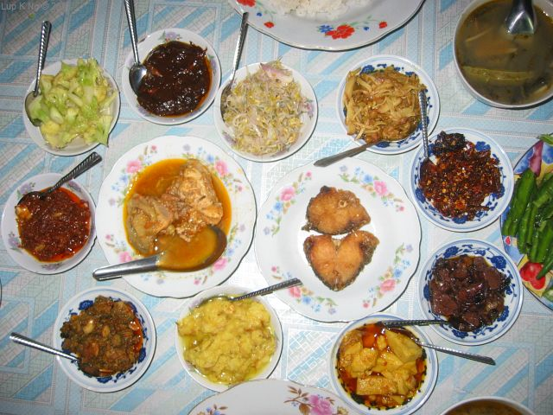
Restaurant Problem

Slide 30
Optimistic Exploration Strategy
Behave initially as if there were wonderful rewards R⁺ scattered all over the place
Define a modified optimistic Bellman update U⁺(s) ← R(s)+γ max_{a} f( Σ_{s} P(s’|s,a)U⁺(s’) , N[s,a])
Truncated exploration function:
f(u,n) = R⁺ if n < N_{e} u otherwise
[Here the agent will try each action in each state at least N_{e} times.]

Slide 31
Complexity
Truncated: at least N_{e}·|S|·|A| steps are needed in order to explore every action in every state
Some costly explorations might not be necessary, or the reward from far-off explorations may be highly discounted
Convergence to optimal policy guaranteed only if each action is tried in each state an infinite number of times!
This works with ADP… But how to perform action selection in TD?
Must also learn the transition model P(s’|s,a)

Slide 32
Q-Values
Learning U is not enough for action selection because a transition model is needed
Solution: learn Q-values: Q(s,a) is the utility of choosing action a in state s
Shift Bellman equation
U(s) = max_{a} Q(s,a)
Q(s,a) = R(s) + γ Σ_{s} P(s’|s,a) max_{a’} Q(s’,a’)
So far, everything is the same… but what about the learning rule?

Slide 33
Q-learning Update
Recall TD:
Update: U(s) ← U(s)+α(N[s])(r+γU(s’)-U(s))
Select action: a ← arg max_{a} f( Σ_{s} P(s’|s,a)U(s’) , N[s,a])
Q-Learning:
Update: Q(s,a) ← Q(s,a)+α(N[s,a])(r+γ max_{a’}Q(s’,a’)-Q(s,a))
Select action: a ← arg max_{a} f( Q(s,a) , N[s,a])
Key difference: average over P(s’|s,a) is “baked in” to the Q function
Q-learning is therefore a model-free active learner

Slide 34
More Issues in RL
Model-free vs. model-based
Model-based techniques are typically better at incorporating prior knowledge
Generalization
Value function approximation
Policy search methods

Slide 35
Large Scale Applications
Game playing
TD-Gammon: neural network representation of Q-functions, trained via self-play
Robot control

Slide 36
Recap
Online learning: learn incrementally with low memory overhead
Key differences between RL methods: what to learn?
Temporal differencing: learn U through incremental updates. Cheap, somewhat slow learning.
Adaptive DP: learn P and R, derive U through policy evaluation. Fast learning but computationally expensive.
Q-learning: learn state-action function Q(s,a), allows model-free action selection
Action selection requires trading off exploration vs. exploitation
Infinite exploration needed to guarantee that the optimal policy is found!

Slide 37
Incremental Least Squares
Recall Least Squares estimate θ = (A^{T}A)⁻¹ A^{T} b
Where A is matrix of x^{(i)}’s, b is vector of y^{(i)}’s (laid out in rows)
NxM
Nx1
x⁽¹⁾
y⁽¹⁾
x⁽²⁾
y⁽²⁾
A =
b =
…
…
x^{(N)}
y^{(N)}

Slide 38
Delta Rule for Linear Least Squares
Delta rule (Widrow-Hoff rule): stochastic gradient descent θ^{(t+1)} = θ^{(t)}+α x (y-θ^{(t)T}x)
O(n) time and space

Slide 39
Incremental Least Squares
Let A^{(t)}, b^{(t)} be A matrix, b vector up to time t θ^{(t)} = (A^{(t)T}A^{(t)})⁻¹ A^{(t)T} b^{(t)}
(T+1)xM
(t+1)x1
A^{(t+1)} =
A^{(t)}
b^{(t+1)} =
b^{(t)}
x^{(t+1)}
y^{(t+1)}

Slide 40
Incremental Least Squares
Let A^{(t)}, b^{(t)} be A matrix, b vector up to time t θ^{(t+1)} = (A^{(t+1)T}A^{(t+1)})⁻¹ A^{(t+1)T} b^{(t+1)}
A^{(t+1)T} b^{(t+1)} =A^{(t)T} b^{(t)} + y^{(t+1)}x^{(t+1)}
(T+1)xM
(t+1)x1
A^{(t+1)} =
A^{(t)}
b^{(t+1)} =
b^{(t)}
x^{(t+1)}
y^{(t+1)}

Slide 41
Incremental Least Squares
Let A^{(t)}, b^{(t)} be A matrix, b vector up to time t θ^{(t+1)} = (A^{(t+1)T}A^{(t+1)})⁻¹ A^{(t+1)T} b^{(t+1)}
A^{(t+1)T} b^{(t+1)} =A^{(t)T} b^{(t)} + y^{(t+1)}x^{(t+1)}
A^{(t+1)T}A^{(t+1)} = A^{(t)T}A^{(t)} + x^{(t+1)}x^{(t+1)T}
(T+1)xM
(t+1)x1
A^{(t+1)} =
A^{(t)}
b^{(t+1)} =
b^{(t)}
x^{(t+1)}
y^{(t+1)}

Slide 42
Incremental Least Squares
Let A^{(t)}, b^{(t)} be A matrix, b vector up to time t θ^{(t+1)} = (A^{(t+1)T}A^{(t+1)})⁻¹ A^{(t+1)T} b^{(t+1)}
A^{(t+1)T} b^{(t+1)} =A^{(t)T} b^{(t)} + y^{(t+1)}x^{(t+1)}
A^{(t+1)T}A^{(t+1)} = A^{(t)T}A^{(t)} + x^{(t+1)}x^{(t+1)T}
(T+1)xM
(t+1)x1
A^{(t+1)} =
A^{(t)}
b^{(t+1)} =
b^{(t)}
x^{(t+1)}
y^{(t+1)}

Slide 43
Incremental Least Squares
Let A^{(t)}, b^{(t)} be A matrix, b vector up to time t θ^{(t+1)} = (A^{(t+1)T}A^{(t+1)})⁻¹ A^{(t+1)T} b^{(t+1)}
A^{(t+1)T} b^{(t+1)} =A^{(t)T} b^{(t)} + y^{(t+1)}x^{(t+1)}
A^{(t+1)T}A^{(t+1)} = A^{(t)T}A^{(t)} + x^{(t+1)}x^{(t+1)T}
Sherman-Morrison Update
(Y + xx^{T})⁻¹ = Y⁻¹ - Y⁻¹ xx^{T} Y⁻¹ / (1 – x^{T} Y⁻¹ x)

Slide 44
Incremental Least Squares
Putting it all together
Store p^{(t)} = A^{(t)T}b^{(t)} Q^{(t)} = (A^{(t)T}A^{(t)})⁻¹
Update p^{(t+1)} = p^{(t)} + y x Q^{(t+1)} = Q^{(t)} - Q^{(t)} xx^{T} Q^{(t)} / (1 – x^{T} Q^{(t)} x) θ^{(t+1)} = Q^{(t+1)}p^{(t+1)}
O(M²) time and space instead of O(M³+MN) time and O(MN) space for OLS
True least squares estimator for any t, (delta rule works only for large t)

